Slide 1
Hinrich Schütze and Christina Lioma
Lecture 16: Flat Clustering

Slide 2
Overview
Recap
Clustering: Introduction
Clustering in IR
K-means
Evaluation
How many clusters?

Slide 3
Outline
Recap
Clustering: Introduction
Clustering in IR
K-means
Evaluation
How many clusters?

Slide 4
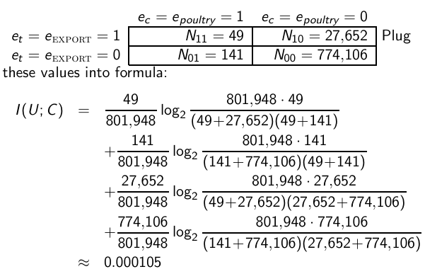
MI example for poultry/ EXPORT in Reuters
4

Slide 5
Linear classifiers
Linear classifiers compute a linear combination or weighted sum of the feature values.
Classification decision:
Geometrically, the equation defines a line (2D), a plane (3D) or a hyperplane (higher dimensionalities).
Assumption: The classes are linearly separable.
Methods for finding a linear separator: Perceptron, Rocchio, Naive Bayes, linear support vector machines, many others
5

Slide 6

A linear classifier in 1D
A linear classifier in 1D is a point described by the equation w₁d₁ = θ
The point at θ/w₁
Points (d₁) with w₁d₁ ≥ are in the class c.
Points (d₁) with w₁d₁ < θ are in the complement class
6

Slide 7
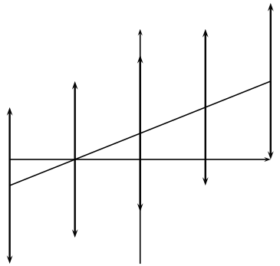
A linear classifier in 2D
A linear classifier in 2D is a line described by the equation w₁d₁ +w₂d₂ = θ
Example for a 2D linear classifier
Points (d₁ d₂) with w₁d₁ + w₂d₂ ≥ θ are in the class c.
Points (d₁ d₂) with w₁d₁ + w₂d₂ < θ are in the complement class
7

Slide 8
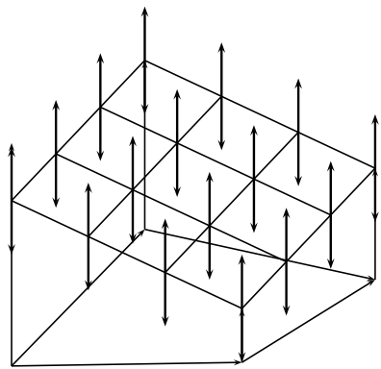
A linear classifier in 3D
A linear classifier in 3D is a plane described by the equation w1d1 + w2d2 + w3d3 = θ
Example for a 3D linear classifier
Points (d1 d2 d3) with w1d1 + w2d2 + w3d3 ≥ θ are in the class c.
Points (d1 d2 d3) with w1d1 + w2d2 + w3d3 < θ are in the complement class
8

Slide 9

Rocchio as a linear classifier
Rocchio is a linear classifier defined by:
where is the normal vector and
9

Slide 10

Naive Bayes as a linear classifier
Naive Bayes is a linear classifier (in log space) defined
by:
where , d_{i} = number of occurrences of t_{i}
in d, and . Here, the index i , 1 ≤ i ≤ M,
refers to terms of the vocabulary (not to positions in d as k did in
our original definition of Naive Bayes)
10

Slide 11
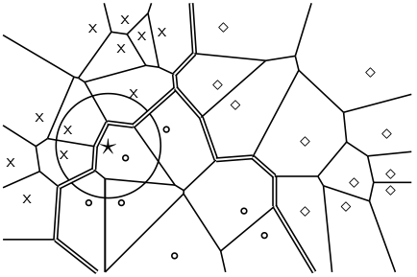
kNN is not a linear classifier
The decision boundaries between classes are piecewise linear . . .
. . . but they are in general not linear classifiers that can be described as
11

Slide 12
Take-away today
What is clustering?
Applications of clustering in information retrieval
K-means algorithm
Evaluation of clustering
How many clusters?
12

Slide 13
Outline
Recap
Clustering: Introduction
Clustering in IR
K-means
Evaluation
How many clusters?

Slide 14
Clustering: Definition
(Document) clustering is the process of grouping a set of documents into clusters of similar documents.
Documents within a cluster should be similar.
Documents from different clusters should be dissimilar.
Clustering is the most common form of unsupervised learning.
Unsupervised = there are no labeled or annotated data.
14

Slide 15
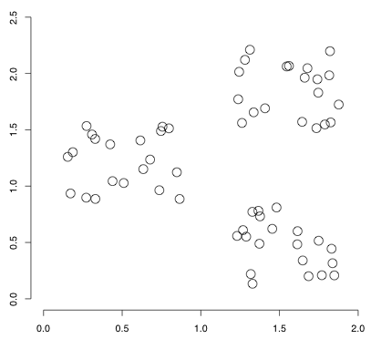
Data set with clear cluster structure
Propose algorithm for finding the cluster structure in this example
15

Slide 16
Classification vs. Clustering
Classification: supervised learning
Clustering: unsupervised learning
Classification: Classes are human-defined and part of the input to the learning algorithm.
Clustering: Clusters are inferred from the data without human input.
However, there are many ways of influencing the outcome of clustering: number of clusters, similarity measure, representation of documents, . . .
16

Slide 17
Outline
Recap
Clustering: Introduction
Clustering in IR
K-means
Evaluation
How many clusters?

Slide 18
The cluster hypothesis
Cluster hypothesis. Documents in the same cluster behave
similarly with respect to relevance to information needs. All
applications of clustering in IR are based (directly or indirectly) on
the cluster hypothesis.
Van Rijsbergen’s original wording: “closely associated documents tend to be relevant to the same requests”.
18

Slide 19
Applications of clustering in IR
Application | What is clustered? | Benefit
Search result clustering | search results | more effective information presentation to user
Scatter-Gather | (subsets of) collection | alternative user interface: “search without typing”
Collection clustering | collection | effective information presentation for exploratory browsing
Cluster-based retrieval | collection | higher efficiency: faster search
19

Slide 20
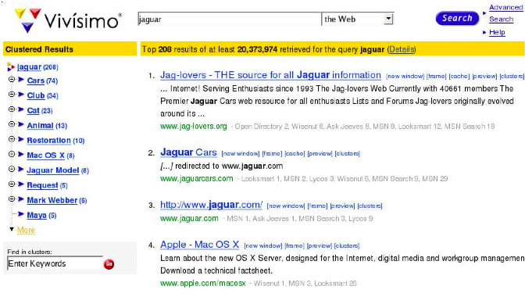
Search result clustering for better navigation
20

Slide 21
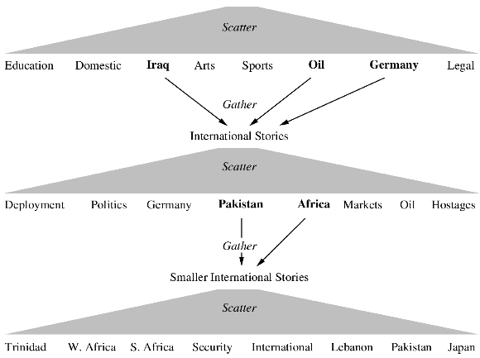
Scatter-Gather
21

Slide 22
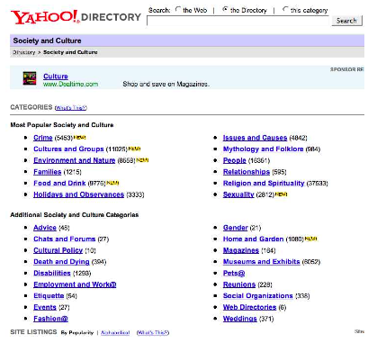
Global navigation: Yahoo
22

Slide 23
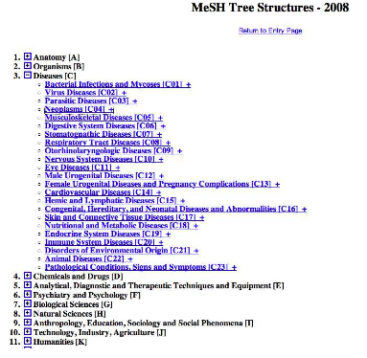
Global navigation: MESH (upper level)
23

Slide 24
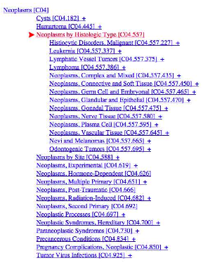
Global navigation: MESH (lower level)
24

Slide 25
Navigational hierarchies: Manual vs. automatic creation
Note: Yahoo/MESH are not examples of clustering.
But they are well known examples for using a global hierarchy for navigation.
Some examples for global navigation/exploration based on clustering:
Cartia
Themescapes
Google News
25

Slide 26
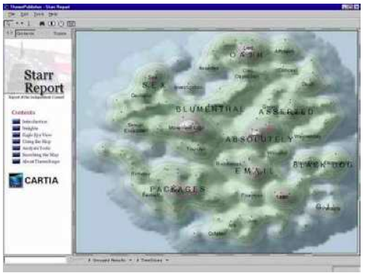
Global navigation combined with visualization (1)
26

Slide 27
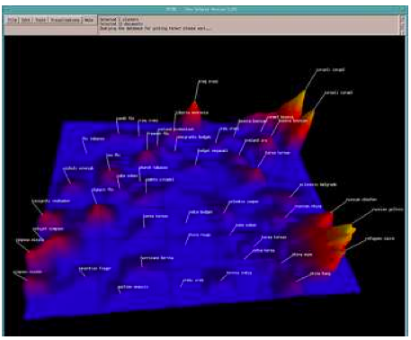
Global navigation combined with visualization (2)
27

Slide 28
Global clustering for navigation: Google News
http://news.google.com
28

Slide 29
Clustering for improving recall
To improve search recall:
Cluster docs in collection a priori
When a query matches a doc d, also return other docs in the cluster containing d
Hope: if we do this: the query “car” will also return docs containing “automobile”
Because the clustering algorithm groups together docs containing “car” with those containing “automobile”.
Both types of documents contain words like “parts”, “dealer”, “mercedes”, “road trip”.
29

Slide 30
Data set with clear cluster structure
Propose algorithm for finding the cluster structure in this example
30

Slide 31
Desiderata for clustering
General goal: put related docs in the same cluster, put unrelated docs in different clusters.
How do we formalize this?
The number of clusters should be appropriate for the data set we are clustering.
Initially, we will assume the number of clusters K is given.
Later: Semiautomatic methods for determining K
Secondary goals in clustering
Avoid very small and very large clusters
Define clusters that are easy to explain to the user
Many others . . .
31

Slide 32
Flat vs. Hierarchical clustering
Flat algorithms
Usually start with a random (partial) partitioning of docs into groups
Refine iteratively
Main algorithm: K-means
Hierarchical algorithms
Create a hierarchy
Bottom-up, agglomerative
Top-down, divisive
32

Slide 33
Hard vs. Soft clustering
Hard clustering: Each document belongs to exactly one cluster.
More common and easier to do
Soft clustering: A document can belong to more than one cluster.
Makes more sense for applications like creating browsable hierarchies
You may want to put sneakers in two clusters:
sports apparel
shoes
You can only do that with a soft clustering approach.
We will do flat, hard clustering only in this class.
See IIR 16.5, IIR 17, IIR 18 for soft clustering and hierarchical clustering
33

Slide 34
Flat algorithms
Flat algorithms compute a partition of N documents into a set of K clusters.
Given: a set of documents and the number K
Find: a partition into K clusters that optimizes the chosen partitioning criterion
Global optimization: exhaustively enumerate partitions, pick optimal one
Not tractable
Effective heuristic method: K-means algorithm
34

Slide 35
Outline
Recap
Clustering: Introduction
Clustering in IR
K-means
Evaluation
How many clusters?

Slide 36
K-means
Perhaps the best known clustering algorithm
Simple, works well in many cases
Use as default / baseline for clustering documents
36

Slide 37
Document representations in clustering
Vector space model
As in vector space classification, we measure relatedness between vectors by Euclidean distance . . .
. . .which is almost equivalent to cosine similarity.
Almost: centroids are not length-normalized.
37

Slide 38

K-means
Each cluster in K-means is defined by a centroid.
Objective/partitioning criterion: minimize the average squared difference from the centroid
Recall definition of centroid:
where we use ω to denote a cluster.
We try to find the minimum average squared difference by iterating two steps:
reassignment: assign each vector to its closest centroid
recomputation: recompute each centroid as the average of the vectors that were assigned to it in reassignment
38

Slide 39
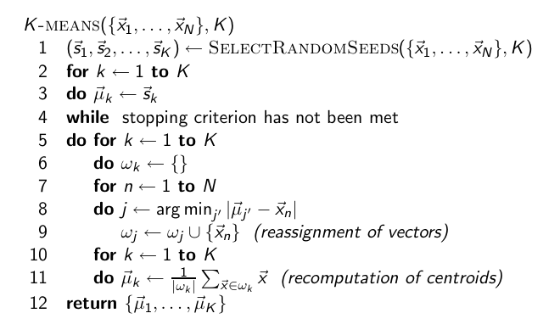
K-means algorithm

Slide 40
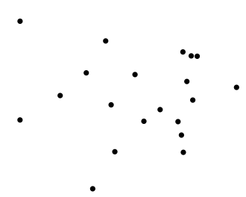
Worked Example: Set of to be clustered

Slide 41
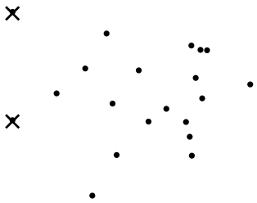
Worked Example: Random selection of initial
centroids
Exercise: (i) Guess what the
optimal clustering into two clusters is in this case; (ii) compute the
centroids of the clusters
41

Slide 42
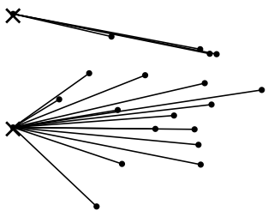
Worked Example: Assign points to closest center

Slide 43
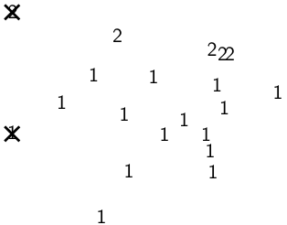
Worked Example: Assignment

Slide 44
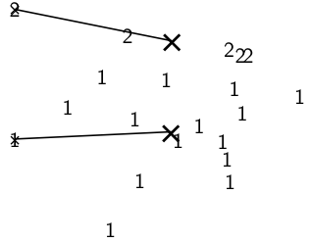
Worked Example: Recompute cluster centroids

Slide 45
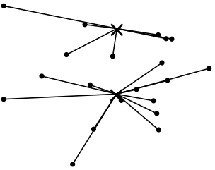
Worked Example: Assign points to closest centroid

Slide 46
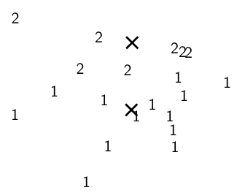
Worked Example: Assignment

Slide 47
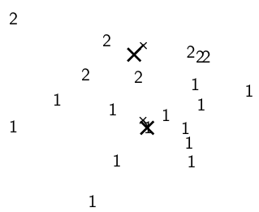
Worked Example: Recompute cluster centroids

Slide 48
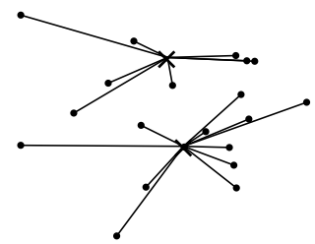
Worked Example: Assign points to closest centroid

Slide 49
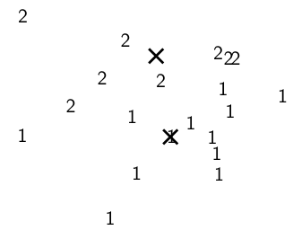
Worked Example: Assignment

Slide 50
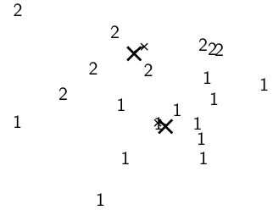
Worked Example: Recompute cluster centroids

Slide 51
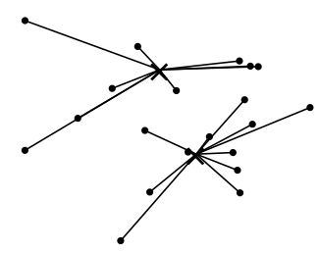
Worked Example: Assign points to closest centroid

Slide 52
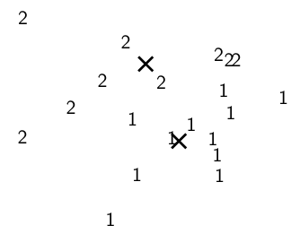
Worked Example: Assignment

Slide 53
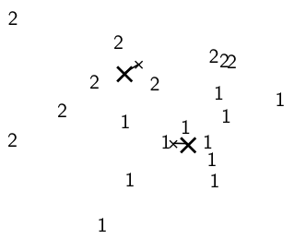
Worked Example: Recompute cluster centroids

Slide 54
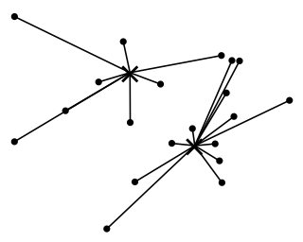
Worked Example: Assign points to closest centroid

Slide 55
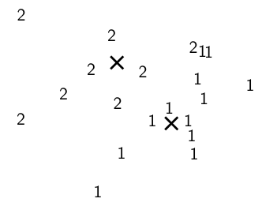
Worked Example: Assignment

Slide 56
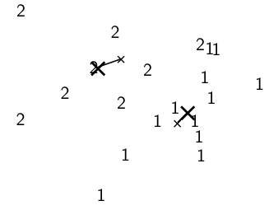
Worked Example: Recompute cluster centroids

Slide 57
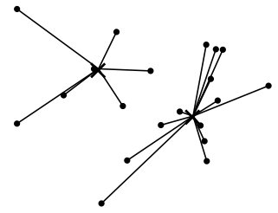
Worked Example: Assign points to closest centroid

Slide 58
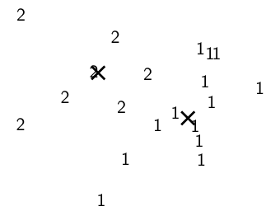
Worked Example: Assignment

Slide 59
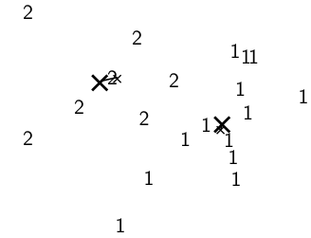
Worked Example: Recompute cluster centroids

Slide 60
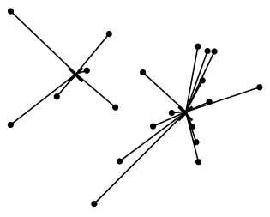
Worked Example: Assign points to closest centroid

Slide 61
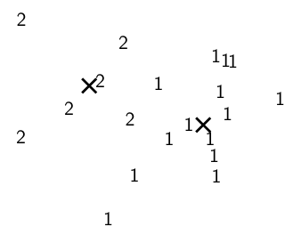
Worked Example: Assignment

Slide 62
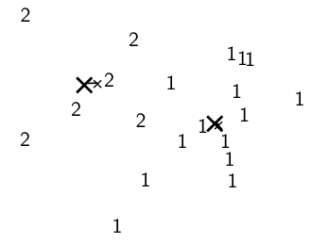
Worked Example: Recompute cluster caentroids

Slide 63
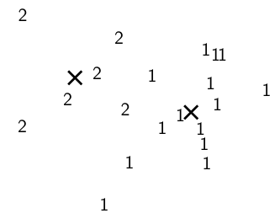
Worked Ex.: Centroids and assignments after convergence

Slide 64
K-means is guaranteed to converge: Proof
RSS = sum of all squared distances between document vector and closest centroid
RSS decreases during each reassignment step.
because each vector is moved to a closer centroid
RSS decreases during each recomputation step.
see next slide
There is only a finite number of clusterings.
Thus: We must reach a fixed point.
Assumption: Ties are broken consistently.
64

Slide 65

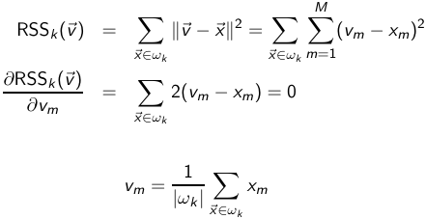
Recomputation decreases average distance
– the residual sum of squares (the “goodness”
measure)
The last line is the componentwise definition of the centroid! We
minimize RSSk when the old centroid is replaced with the new
centroid. RSS, the sum of the RSSk , must then also decrease
during recomputation.
65

Slide 66
K-means is guaranteed to converge
But we don’t know how long convergence will take!
If we don’t care about a few docs switching back and forth, then convergence is usually fast (< 10-20 iterations).
However, complete convergence can take many more iterations.
66

Slide 67
Optimality of K-means
Convergence does not mean that we converge to the optimal clustering!
This is the great weakness of K-means.
If we start with a bad set of seeds, the resulting clustering can be horrible.
67

Slide 68
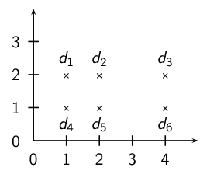
Convergence Exercise: Suboptimal clustering
What is the optimal clustering for K = 2?
Do we converge on this clustering for arbitrary seeds d_{i} , d_{j}?
68

Slide 69
Initialization of K-means
Random seed selection is just one of many ways K-means can be initialized.
Random seed selection is not very robust: It’s easy to get a suboptimal clustering.
Better ways of computing initial centroids:
Select seeds not randomly, but using some heuristic (e.g., filter out outliers or find a set of seeds that has “good coverage” of the document space)
Use hierarchical clustering to find good seeds
Select i (e.g., i = 10) different random sets of seeds, do a K-means clustering for each, select the clustering with lowest RSS
69

Slide 70
Time complexity of K-means
Computing one distance of two vectors is O(M).
Reassignment step: O(KNM) (we need to compute KN document-centroid distances)
Recomputation step: O(NM) (we need to add each of the document’s < M values to one of the centroids)
Assume number of iterations bounded by I
Overall complexity: O(IKNM) – linear in all important dimensions
However: This is not a real worst-case analysis.
In pathological cases, complexity can be worse than linear.
70

Slide 71
Outline
Recap
Clustering: Introduction
Clustering in IR
K-means
Evaluation
How many clusters?

Slide 72
What is a good clustering?
Internal criteria
Example of an internal criterion: RSS in K-means
But an internal criterion often does not evaluate the actual utility of a clustering in the application.
Alternative: External criteria
Evaluate with respect to a human-defined classification
72

Slide 73
External criteria for clustering quality
Based on a gold standard data set, e.g., the Reuters collection we also used for the evaluation of classification
Goal: Clustering should reproduce the classes in the gold standard
(But we only want to reproduce how documents are divided into groups, not the class labels.)
First measure for how well we were able to reproduce the classes: purity
73

Slide 74

External criterion: Purity
Ω= {ω₁, ω₂, . . . , ω_{K}} is the set of clusters and C = {c₁, c₂, . . . , c_{J}} is the set of classes.
For each cluster ω_{k} : find class c_{j} with most members n_{kj} in ω_{k}
Sum all n_{kj} and divide by total number of points
74

Slide 75
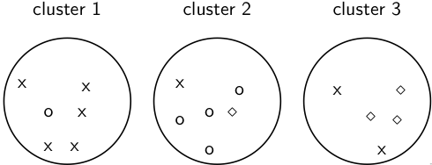
Example for computing purity
To compute purity: 5 = max_{j} |ω₁ ∩ c_{j} | (class x, cluster 1);
4 = max_{j} |ω₂ ∩ c_{j} | (class o, cluster 2); and 3 = max_{j} |ω₃ ∩ c_{j} |
(class ⋄, cluster 3). Purity is (1/17) × (5 + 4 + 3) ≈ 0.71.
75

Slide 76




Rand index
Definition:
Based on 2x2 contingency table of all pairs of documents:
TP+FN+FP+TN is the total number of pairs.
There are pairs for N documents.
Example: = 136 in o/⋄/x example
Each pair is either positive or negative (the clustering puts the two documents in the same or in different clusters) . . .
. . . and either “true” (correct) or “false” (incorrect): the clustering decision is correct or incorrect.
76

Slide 77


Rand Index: Example
As an example, we compute RI for the o/⋄/x example. We first
compute TP + FP. The three clusters contain 6, 6, and 5 points,
respectively, so the total number of “positives” or pairs of
documents that are in the same cluster is:
Of these, the x pairs in cluster 1, the o pairs in cluster 2, the ⋄
pairs in cluster 3, and the x pair in cluster 3 are true positives:
Thus, FP = 40 − 20 = 20. FN and TN are computed similarly.
77

Slide 78
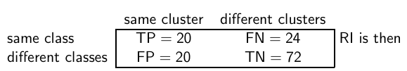
Rand measure for the o/⋄/x example
(20 + 72)/(20 + 20 + 24 + 72) ≈ 0.68.
78

Slide 79
Two other external evaluation measures
Two other measures
Normalized mutual information (NMI)
How much information does the clustering contain about the classification?
Singleton clusters (number of clusters = number of docs) have maximum MI
Therefore: normalize by entropy of clusters and classes
F measure
Like Rand, but “precision” and “recall” can be weighted
79

Slide 80
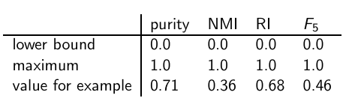
Evaluation results for the o/⋄/x example
All four measures range from 0 (really bad clustering) to 1 (perfect
clustering).
80

Slide 81
Outline
Recap
Clustering: Introduction
Clustering in IR
K-means
Evaluation
How many clusters?

Slide 82
How many clusters?
Number of clusters K is given in many applications.
E.g., there may be an external constraint on K. Example: In the case of Scatter-Gather, it was hard to show more than 10–20 clusters on a monitor in the 90s.
What if there is no external constraint? Is there a “right” number of clusters?
One way to go: define an optimization criterion
Given docs, find K for which the optimum is reached.
What optimiation criterion can we use?
We can’t use RSS or average squared distance from centroid as criterion: always chooses K = N clusters.
82

Slide 83
Exercise
Your job is to develop the clustering algorithms for a competitor to news.google.com
You want to use K-means clustering.
How would you determine K?
83

Slide 84
Simple objective function for K (1)
Basic idea:
Start with 1 cluster (K = 1)
Keep adding clusters (= keep increasing K)
Add a penalty for each new cluster
Trade off cluster penalties against average squared distance from centroid
Choose the value of K with the best tradeoff
84

Slide 85
Simple objective function for K (2)
Given a clustering, define the cost for a document as (squared) distance to centroid
Define total distortion RSS(K) as sum of all individual document costs (corresponds to average distance)
Then: penalize each cluster with a cost λ
Thus for a clustering with K clusters, total cluster penalty is Kλ
Define the total cost of a clustering as distortion plus total cluster penalty: RSS(K) + Kλ
Select K that minimizes (RSS(K) + Kλ)
Still need to determine good value for λ . . .
85

Slide 86
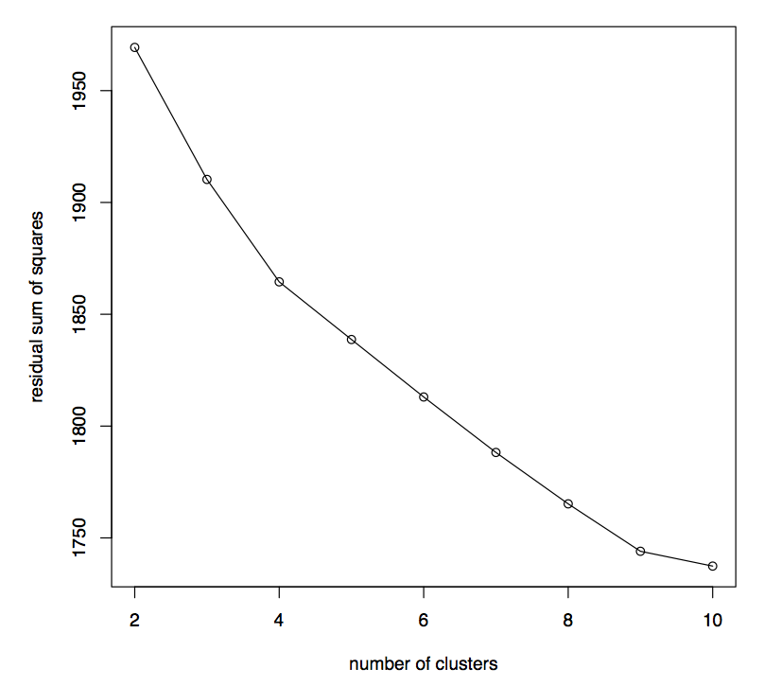
Finding the “knee” in the curve
Pick the number of
clusters where curve
“flattens”. Here: 4 or 9.
86

Slide 87
Take-away today
What is clustering?
Applications of clustering in information retrieval
K-means algorithm
Evaluation of clustering
How many clusters?
87

Slide 88
Resources
Chapter 16 of IIR
Resources at http://ifnlp.org/ir
K-means example
Keith van Rijsbergen on the cluster hypothesis (he was one of
the originators)
Bing/Carrot2/Clusty: search result clustering
88

